Slide 1
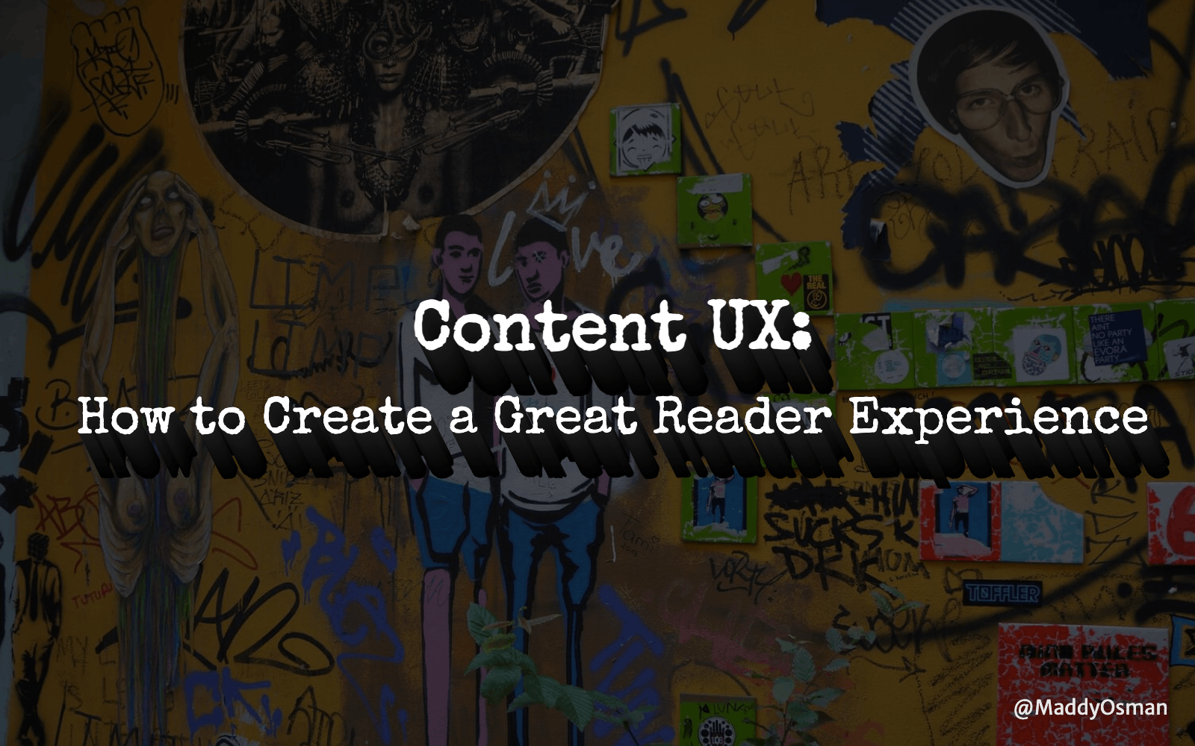
Notes:
https://phoenix.wordcamp.org/2023/session/content-ux-how-to-create-a-great-reader-experience/We're going to talk about:Information architecture best practicesGoogle's quality rater guidelines and what they say about determining a search result’s quality and ability to meet a searcher’s needsHow to optimize content in light of Google's Helpful Content algorithm updateI've pinned a link to my slides on Twitter.---There’s a wide range of quality when it comes to online content. Google’s Helpful Content algorithm update helped set the record straight regarding what the search giant considers useful to humans and how content created specifically (and only) for search will not be able to effectively rank in relevant search moving forward.So what does it mean to create something that your target audience will enjoy consuming, while also achieving business goals? In this talk, we’ll discuss content user experience (UX) best practices, including:– Takeaways from the Helpful Content Google algorithm update– What Google’s Quality Rater Guidelines tell us about how Google determines a search result’s quality and ability to meet a searcher’s needs– Practical tips to immediately put into practice, like incorporating a table of contents, how to complement copy with visuals, and text formatting best practices

Slide 2
Notes:
Maddy Osman is an SEO Content Strategist who works with clients like AAA, Automattic, Kinsta, and Sprout Social. Her background in WordPress web design contributes to a well-rounded understanding of SEO and how to connect brands to relevant search prospects. Learn more about her process and experience on her website, www.The-Blogsmith.com and read her latest articles on Twitter: @MaddyOsman.

Slide 4
Notes:
Several concepts shared here are verbatim from our style guideAccess it yourself using this link

Slide 5
Notes:
"don't bury the lede"get to the point. make it skimmablecreating whitespace (also, bullet lists)reading a book vs reading online examplelong sentences = run on

Slide 6
Notes:
we'll start with headings, then paragraphs, then sentencesPAA/FAQheading styles: h1, h2, h3

Slide 7
Notes:
Nobody wants to read a wall of text

Slide 8
Notes:
Don't make the reader read til the end of the sentence to understand what it's aboutGreat to have variation in terms of sentence length

Slide 9
Notes:
Don't have the expectation they'll read the whole piece of content, might skip aroundGoogle Docs to WP: notes

Slide 11
Notes:
formatting consideration - how does it add or take away from the reader experience?

Slide 12
Notes:
Thoughtful formatting = a great reader experience.Consistency via parallelism is one way to be thoughtful with your formatting. Here are the examples of parallelism from the previous slide.flip back to question to give people context after seeing the answer?

Slide 15
Notes:
get a moment of familiarity and recognition - but it wanes to give way to a feeling of lazinesssure you've seen this imageproblem is that it's not really distinct or representative of any brandBy using popular stock assets, your target audience may pick up on and be turned off by it. Seeing the same stock photo used repeatedly by different brands comes across as lazy

Slide 16
Notes:
The copy itself is just one piece of the puzzle. Visuals, formatting, and the user experience all influence the effectiveness of a piece of content for its stated goal.

Slide 19
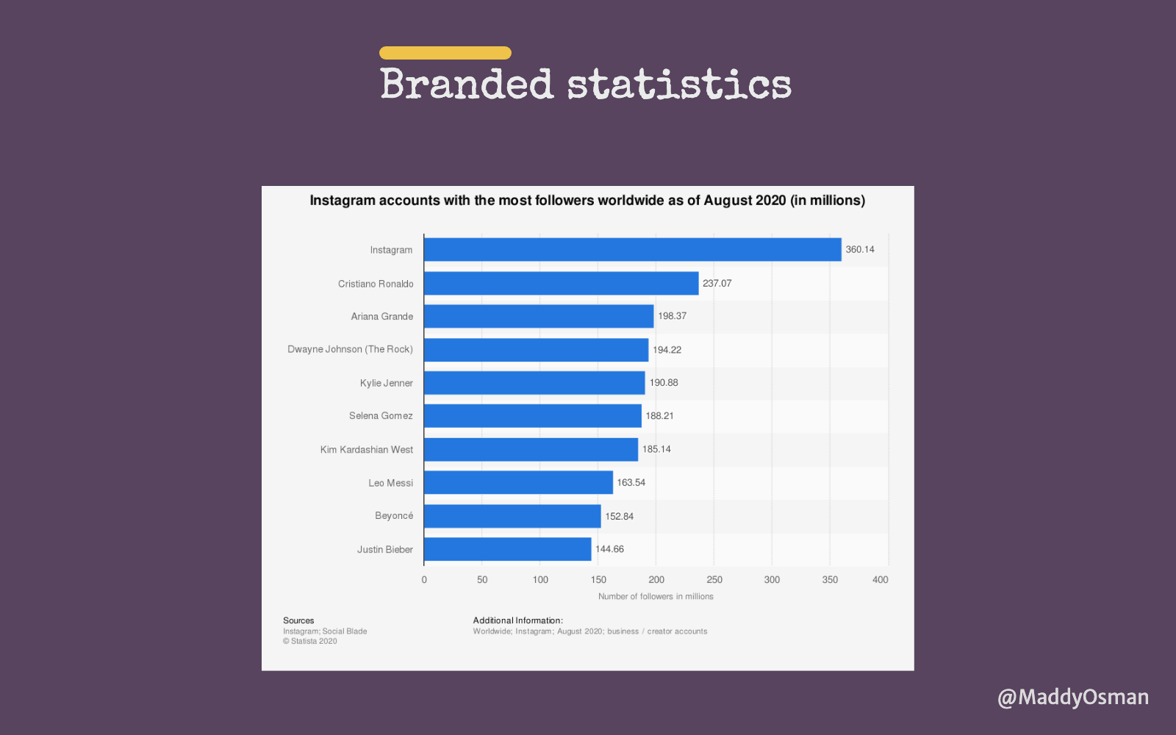

Slide 20
Notes:
increases sharability

Slide 22
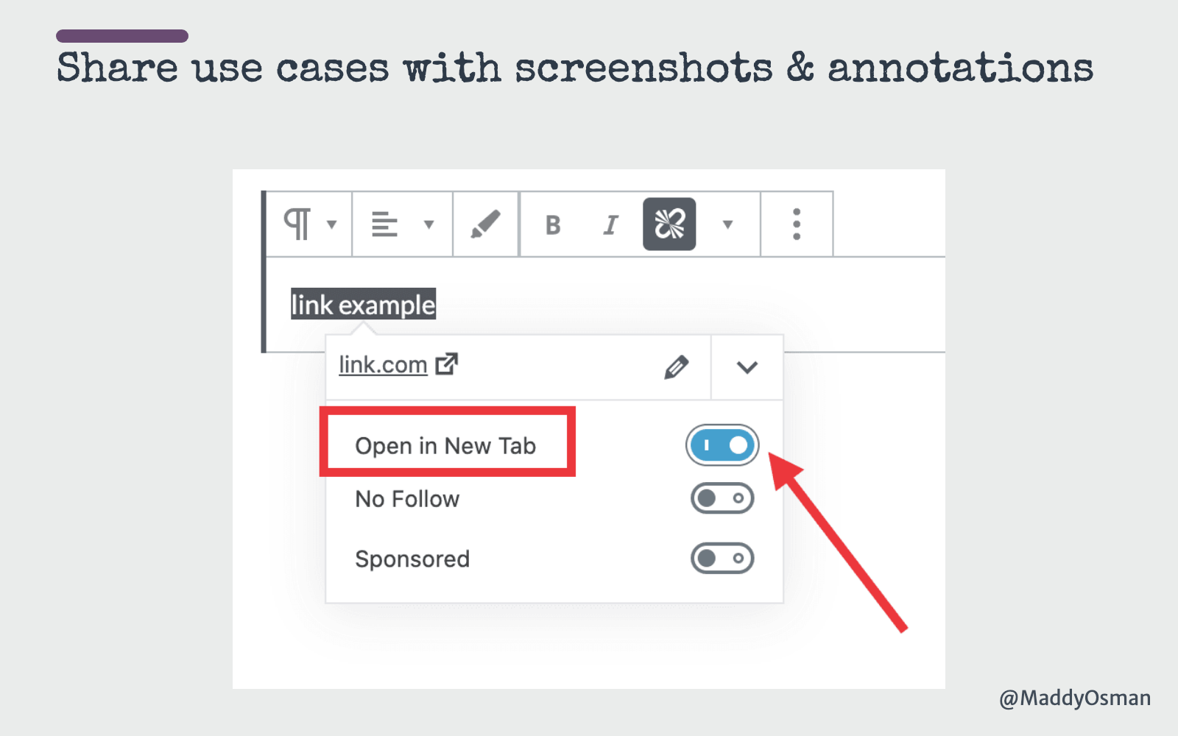

Slide 23
Notes:
Takeaway:For every ~300 words or so, suggest:new subheadingvisualblockquote

Slide 25
Notes:
Throughout this presentation, I'll be referring to specific sections of the Quality Rater Guidelines — follow along with my highlighted copy at blgsmth.tips/QRGI've also included the most-up-to-date version for your download convenience.article on the blogsmith's blog

Slide 27
Notes:
Have to demonstrate a high degree of time, effort, expertise, talent, and skill.

Slide 28
Notes:
Used to be E-A-T, but added "experience" to latest version of QRGConcepts might seem vague but still a great overarching compass for creating content

Slide 29
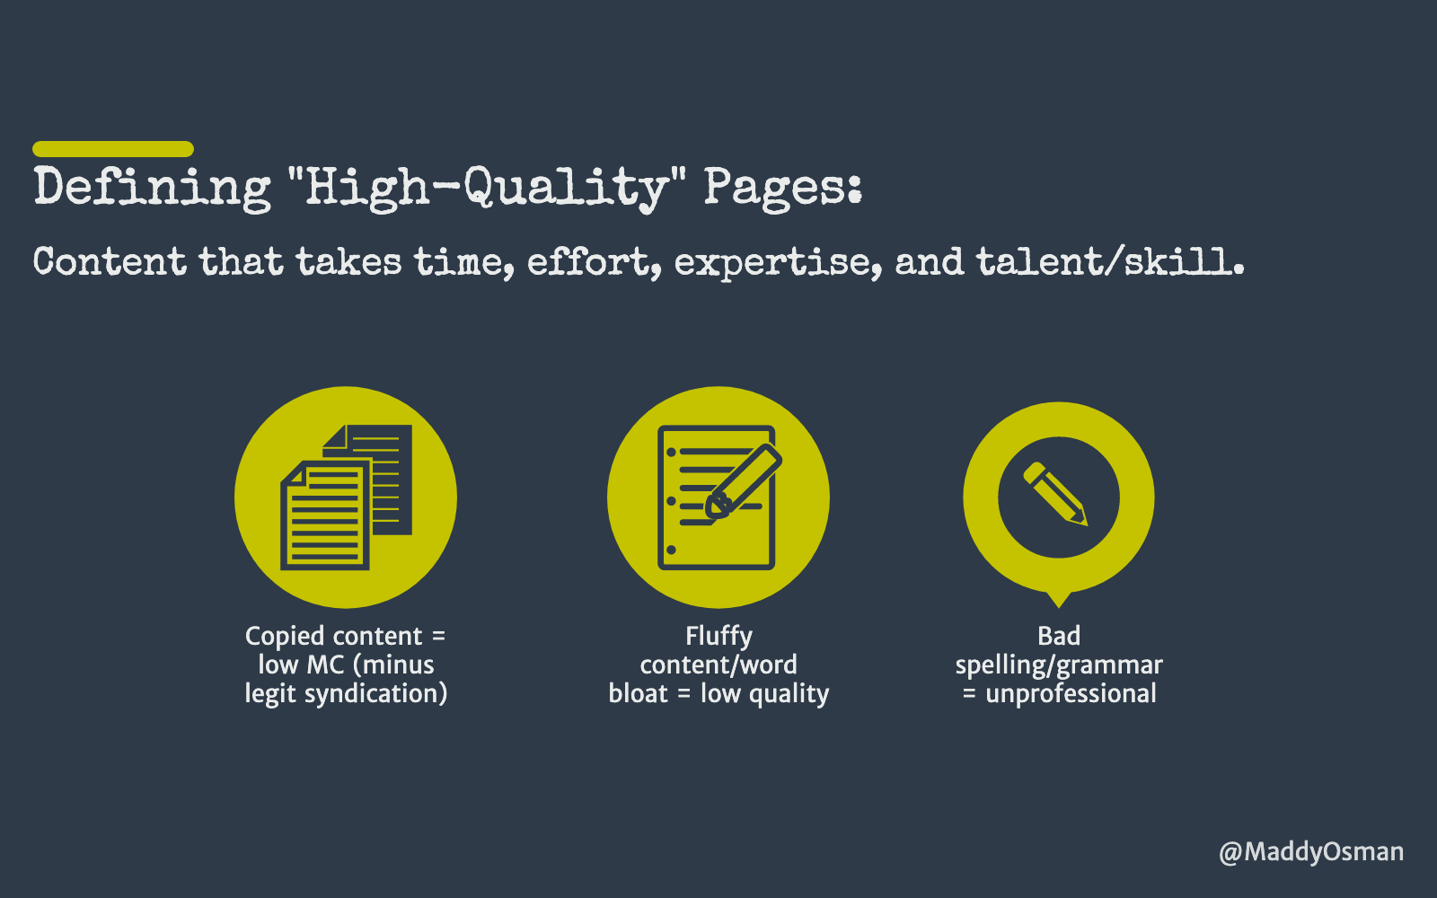
Notes:
Definition of high quality content: content that takes time, effort, expertise, and talent/skill. (Pg 64)Copied content = low MC (minus legit syndication like Business2Community or Medium in my experience - wait a week)Fluffy content/word bloat = low quality (pg 52)Bad spelling/grammar = unprofessional. ideally, have a human editor or use grammarly.Meaningless statements don’t add value, contribute to a low rating (pg 35)Need to cite sources (pg 35)

Slide 30
Notes:
Almost impossible to get "highest"

Slide 31
Notes:
Needs met:Just as it’s hard to get fully meets, it’s hard to get fails to meet.Pg 136 - The Page Quality rating slider does not depend on the query. Do not think about the query when assigning a Page Quality rating to the LP (landing page).Pg 137 and above - page quality can be high even if the needs aren’t met for a querypg 138 - When giving Needs Met ratings for results involving different query interpretations, think about how likely the query interpretation is and how helpful the result is.It helps to dive into the SERPs yourself to try and understand the topic and the positioning/wording of currently ranking results.A very helpful result for a dominant interpretation should be rated Highly Meets, because it is very helpful for many or most users. Some queries with a dominant interpretation have a FullyM result.A very helpful result for a common interpretation may be Highly Meets or Moderately Meets, depending on how likely the interpretation is.A very helpful result for a very minor interpretation may be Slightly Meets or lower because few users may be interested in that interpretation.There are some interpretations that are so unlikely that results should be rated FailsM. We call these “no chance” interpretations.

Slide 33
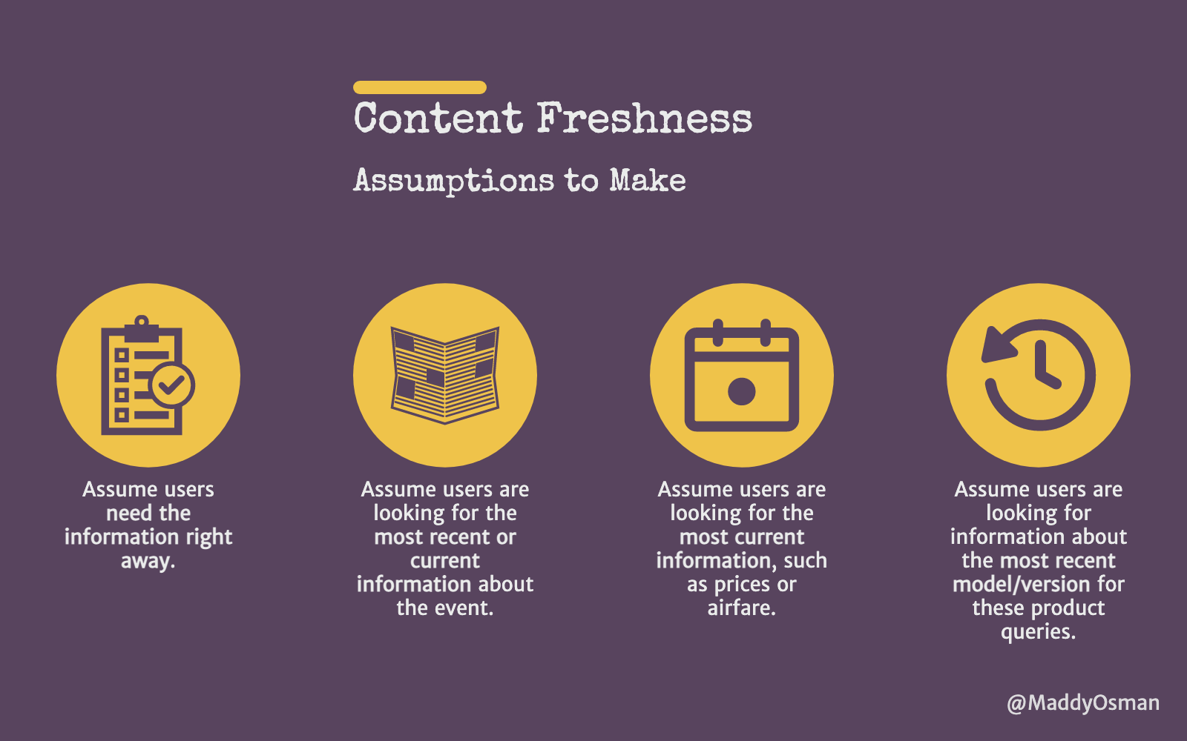
Notes:
Freshness is an important concept for determining if needs are metModerately meets criteria - less up to date (pg 109)Pg 147 - freshness (important for things that change often, like digital marketing…):

Slide 34
Notes:
A hypothetical page on a harmless topic is not considered YMYL because it doesn’t present any risk.Understanding who operates a website and its content creators contributes to the overall page quality rating upon assessing any potential harm or spammy nature of said page.In the previous version (page 24) they stated that creating high quality content would take a significant amount of effort, expertise and talent - In the new version (page 22) they removed the word "time" and added "originality".This update reflects Google's focus on original content.Google is increasingly focusing on the originality of content and presence of insights not found elsewhere. Google is focusing on accuracy and alignment with expert consensus for YMYL topics.

Slide 35
Notes:
https://www.searchenginejournal.com/what-googles-quality-rater-guidelines-tell-us-about-ux/388139/UX: Interstitials make it difficult to use MC (pg 34) - link to popup guidelinesA good page sets expectations for wherever it’s leading you (online banking login example, page 30) + clickbaitIt also addresses expectations (adopting a child from Iraq example pg 36)Clickbait headings detract from high MC (page 33)There should be page titles, and the titles should describe page content (pg 33)Pg 111 - A result with a very misleading or exaggerated title should be rated Slightly Meets or lower, due to the poor user experience that occurs when the landing page does not match the expectation of the user when clicking or tapping on the result.Too many/large ads hurt UX and should be assigned a low rating (pg 36)That said, Google recognizes that ads don’t automatically equal low quality. They may be the reason the site can continue existing.Pag 103 hits on the impact of mobile usability concerns [broadway tickets]Pg 112 - abe lincolns bday, tho present in result (when clicking through), not prominent and thus not as good at meeting needsPg 117 - Unless you feel the user intent to download an app is strong, results that allow users to download apps are generally less helpful. Mobile users want answers and results right away, at that moment, and may not be able to spend a lot of time downloading and installing apps.

Slide 36
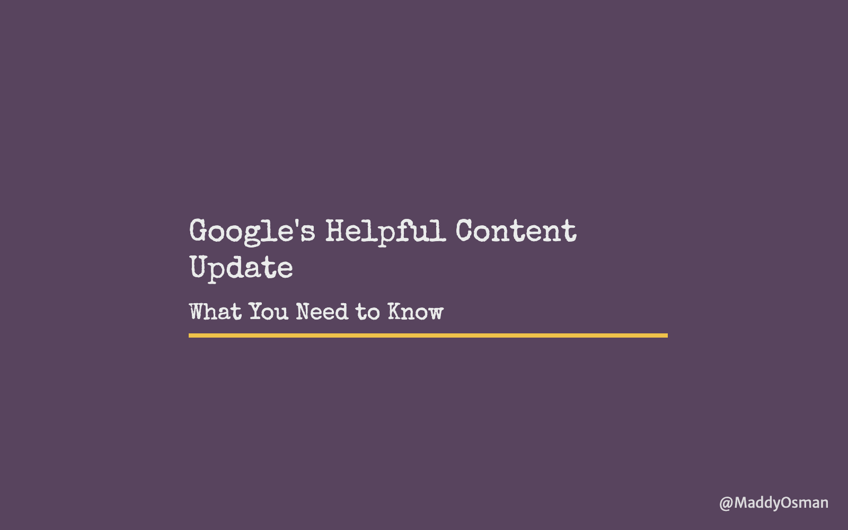
Notes:
https://www.theblogsmith.com/google-helpful-content-update/

Slide 38
Notes:
https://developers.google.com/search/blog/2022/08/helpful-content-update

Slide 39
Notes:
https://developers.google.com/search/blog/2022/08/helpful-content-update

